Slide 1
October 24th, 2012
A
Sign in to
WeScheme
Open "Rocket Height"
Copy the code and paste into a new program. Use your and your partners name.
B
What is the contract for rectangle?

Slide 2
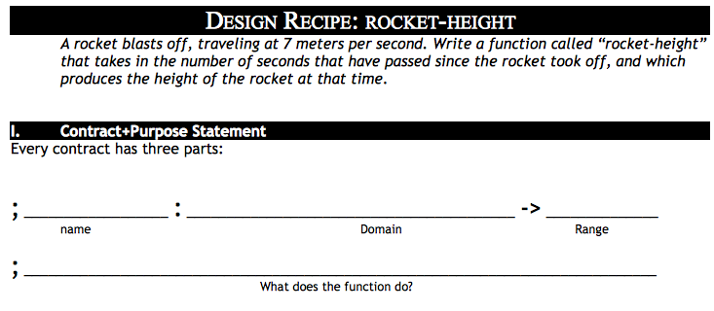

Slide 3
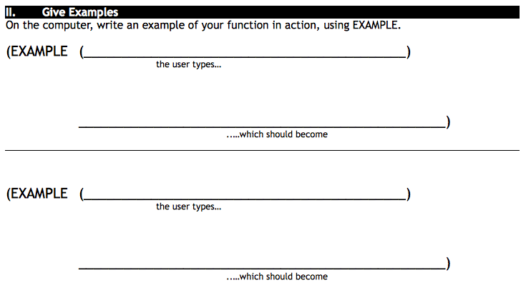
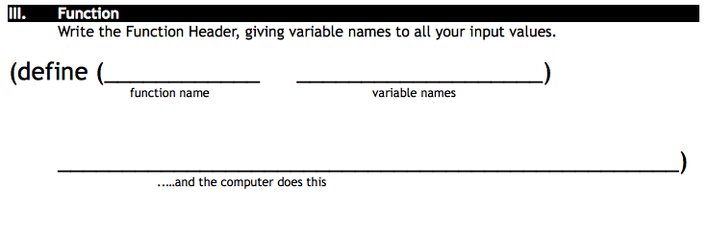

Slide 4
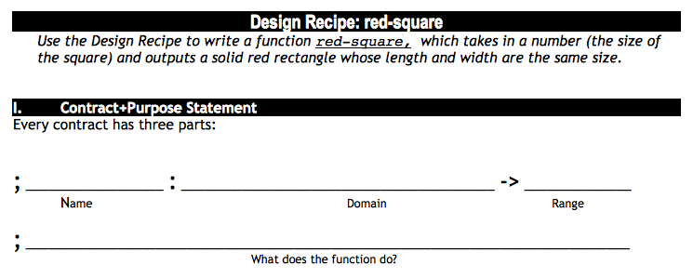

Slide 5
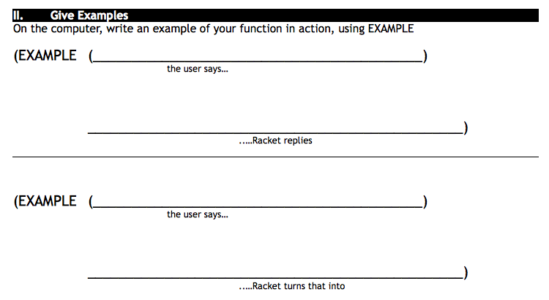
yard-area 50 60
(* 50 60)

Slide 6
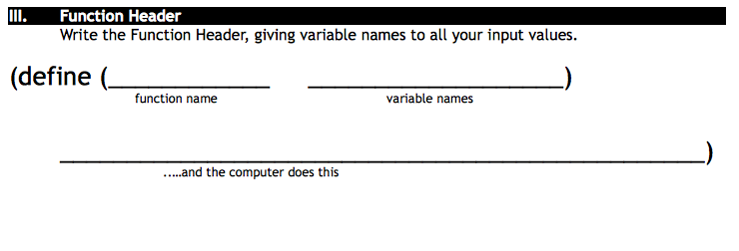

Slide 7
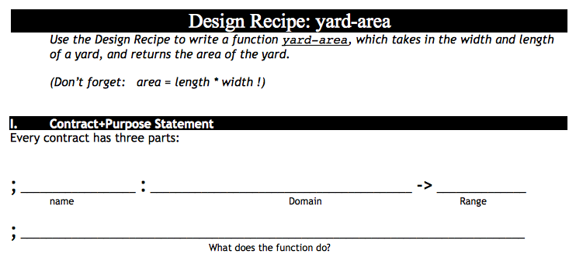
October 25th, 2012
B
Take out Lesson 4 Homework and your lesson 4 workbook
Write the contract for yard-area
Enter the contract into wescheme with your
A
Take out Lesson 4 Homework and your lesson 4 workbook
Write the contract for yard-area
Enter the contract into wescheme with your

Slide 8
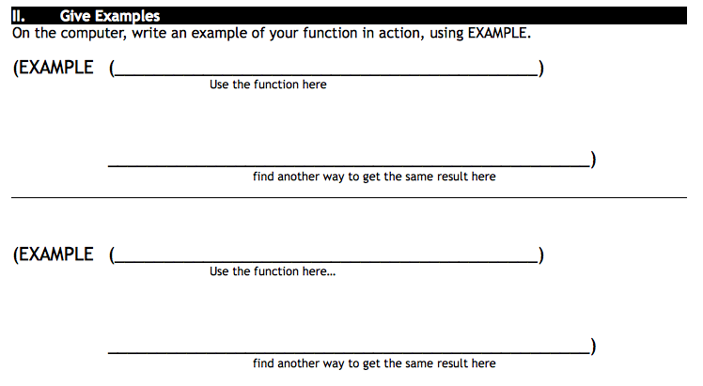

Slide 9
